Slide 1

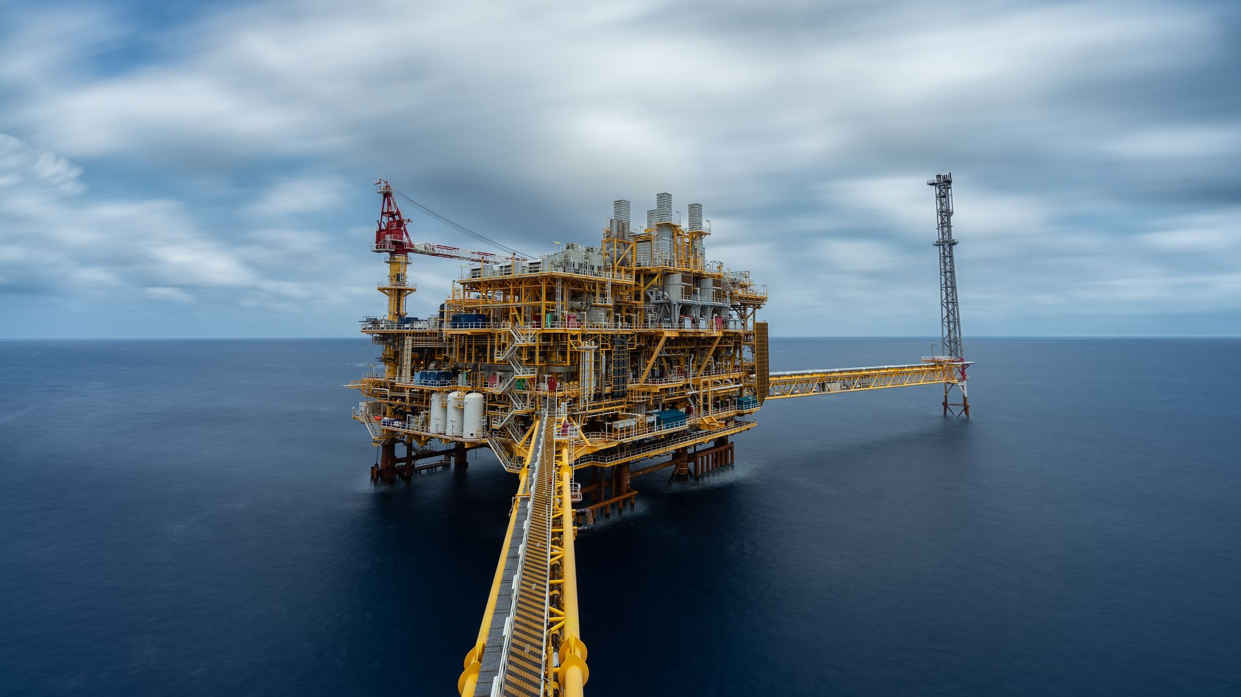
WELL PREDICTIONS (Chevron Oil Peak Rate Prediction)
Team: Well-Done Warriors
Rahul Krishna Gunneri Surya Pavan Peruri Nikhita Peddi Mohana Krishna Koripella

Slide 2


Road Map
Data Wrangling
01
Data Visulaization
02
Findings and Analysis
03
Models
04
Predictive Accuracy
05

Slide 3
Data Wrangling
Handling Null Values
Remove columns where null values are more than 80%.
Imputation using K –Means
Imputation using KNN

Slide 4
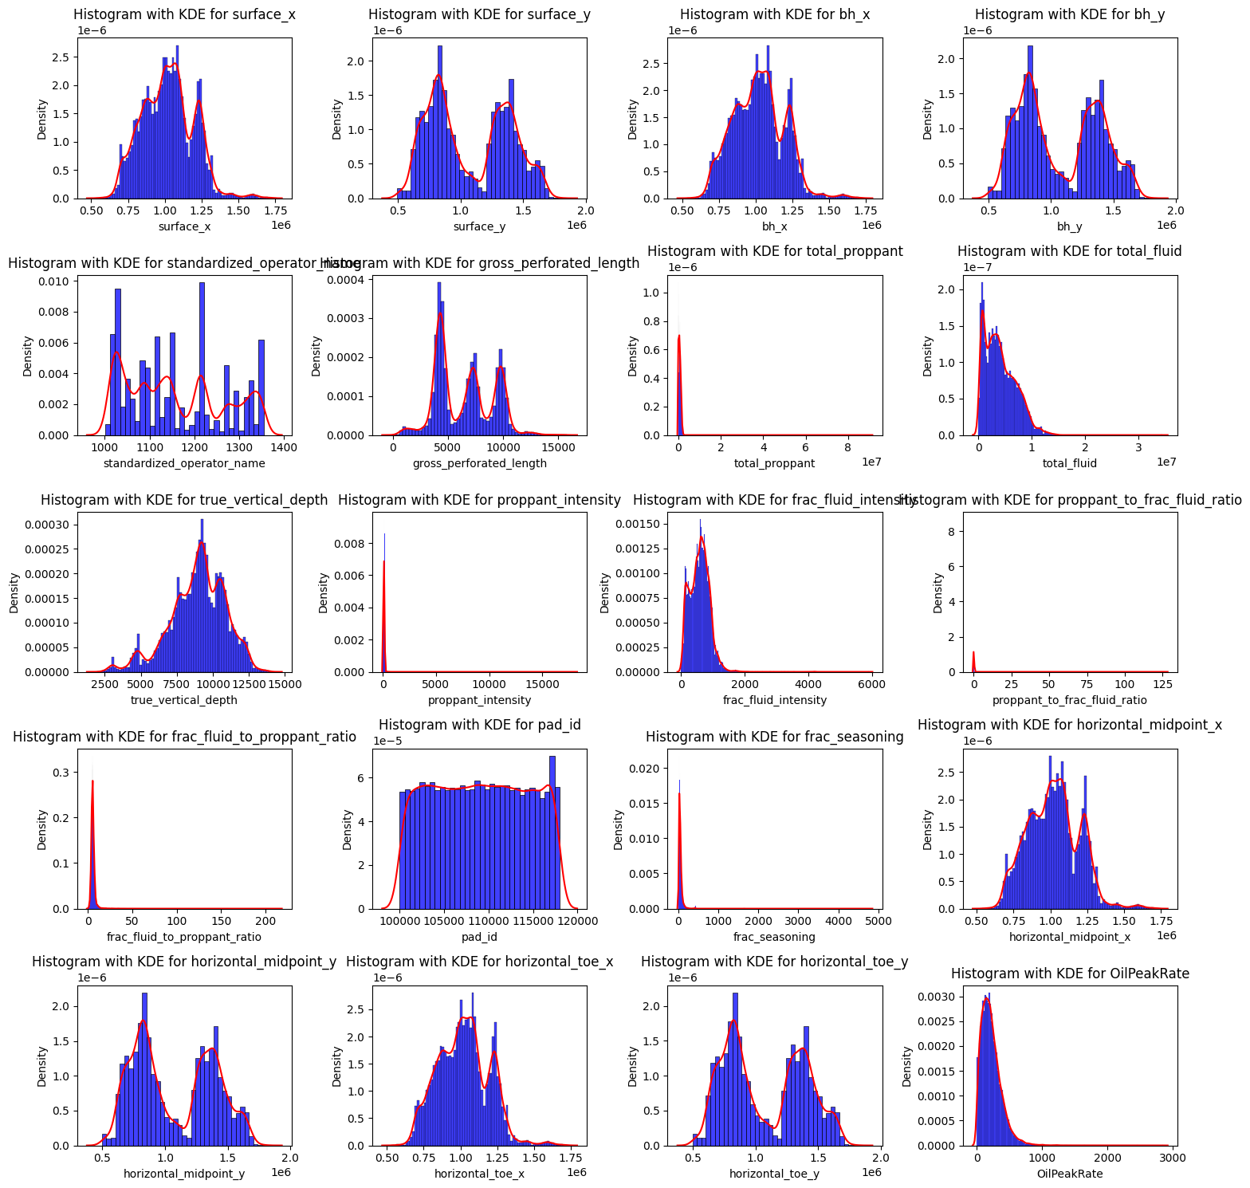
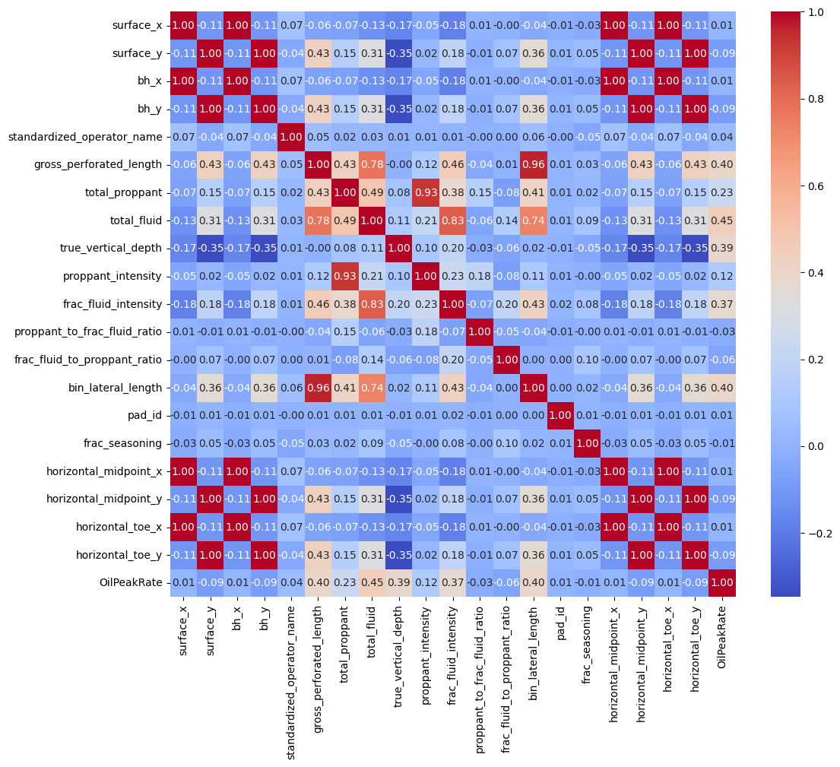
Data Visualization

Slide 5
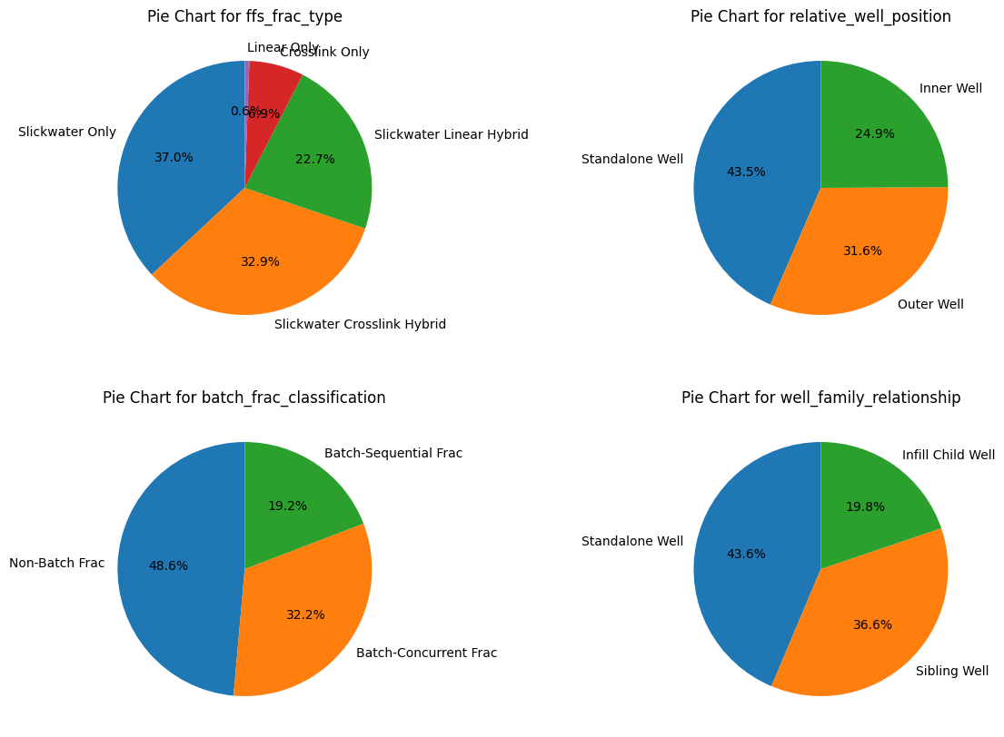
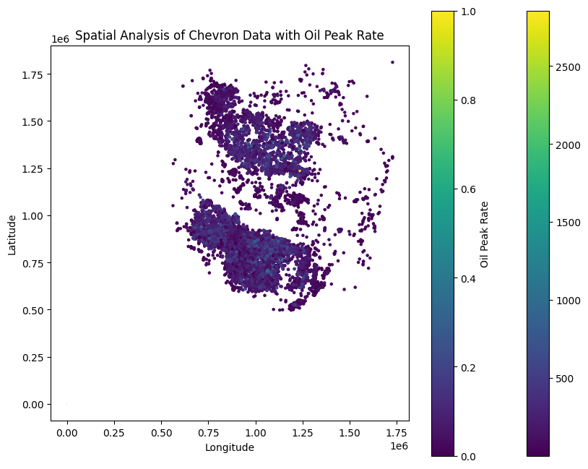
Data Visualization

Slide 6

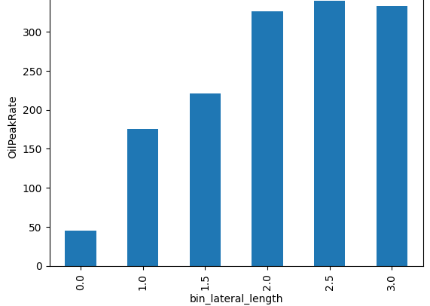
Findings and Analysis
High correlation between total_proppant, proppant intensity, gross_perforted_length, bin_lateral length.
Increasing 'bin_lateral_length' and higher 'OilPeakRate,' suggesting that 'bin_lateral_length' could be a crucial feature for enhancing the accuracy of predictive models in forecasting oil peak production rates.

Slide 7
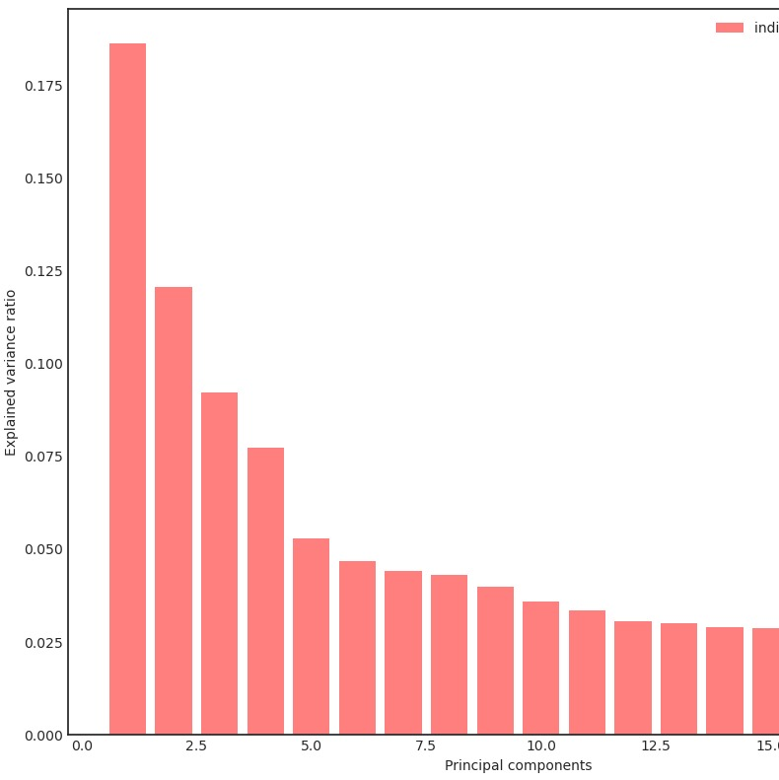
Feature Engineering
PCA, cumulative variance>0.9 -> 16 columns
cumulative variance >0.95 ->18 columns

Slide 8
Modelling
Stage 1:
Model training
Without null values
Stage 2:
Imputing null values with predicted values
SGD Regressor
XGBoost
SVM RGB kernel
Decision Tree
KNN
Random Forest
CatBoost Regressor
Stage 3:
Complete data training on model

Slide 9
Root Mean Square Error
The final model XGBoost has a R -2 score of 0.63 and the final RMSE of 93.69
Models | Before Feature Selection | After Feature Sellection
XGBoost | 95.26487 | 93.69
SVM RGB kernel | 129.2657 | ---
Decision Tree | 137.83 | ---
KNN | 114.20 | ---
Random Forest | 95.09 | 93.85
CatBoostRegressor | 95.45 | 120.45

Slide 10

THANK YOU!!!

